Slide 1
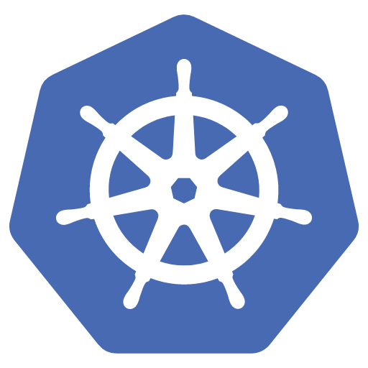
Automated Workflow for Scalable AI using
Mărgărit Darius

Slide 2
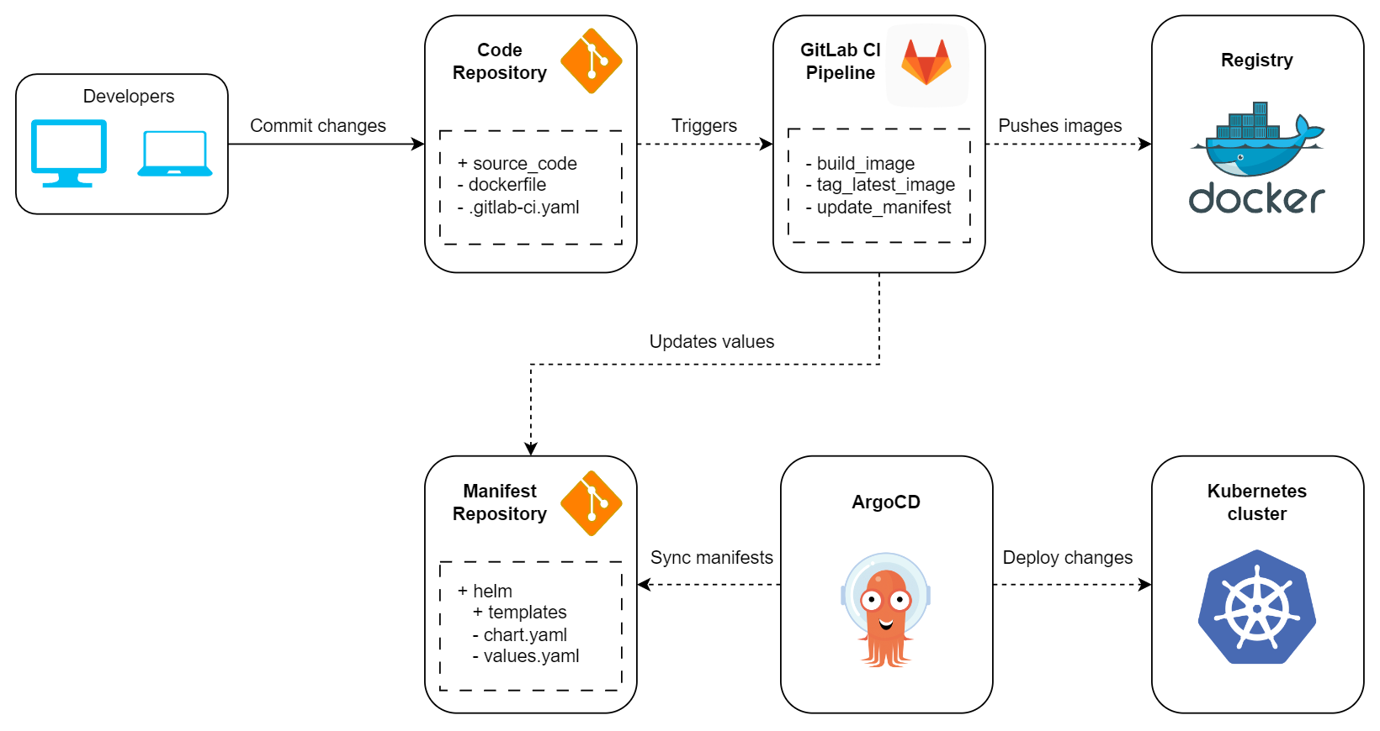
Building and Deploying Applications on Kubernetes

Slide 3
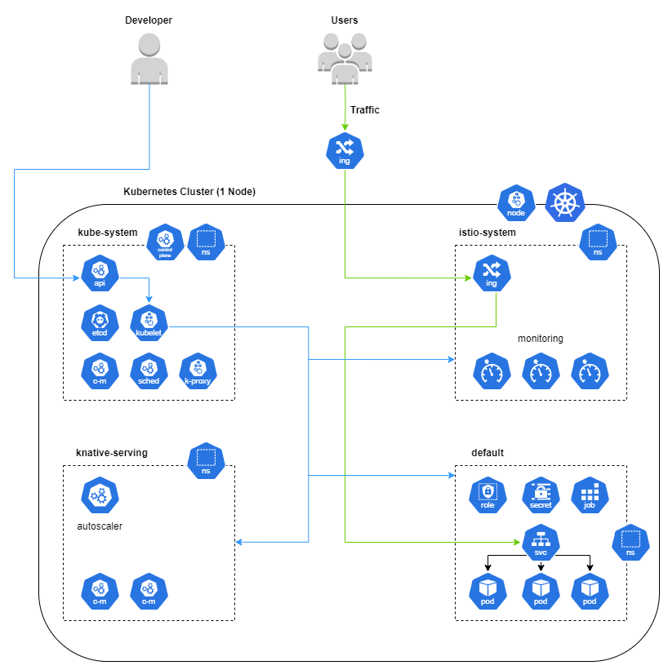
Kubernetes Cluster Architecture

Slide 4
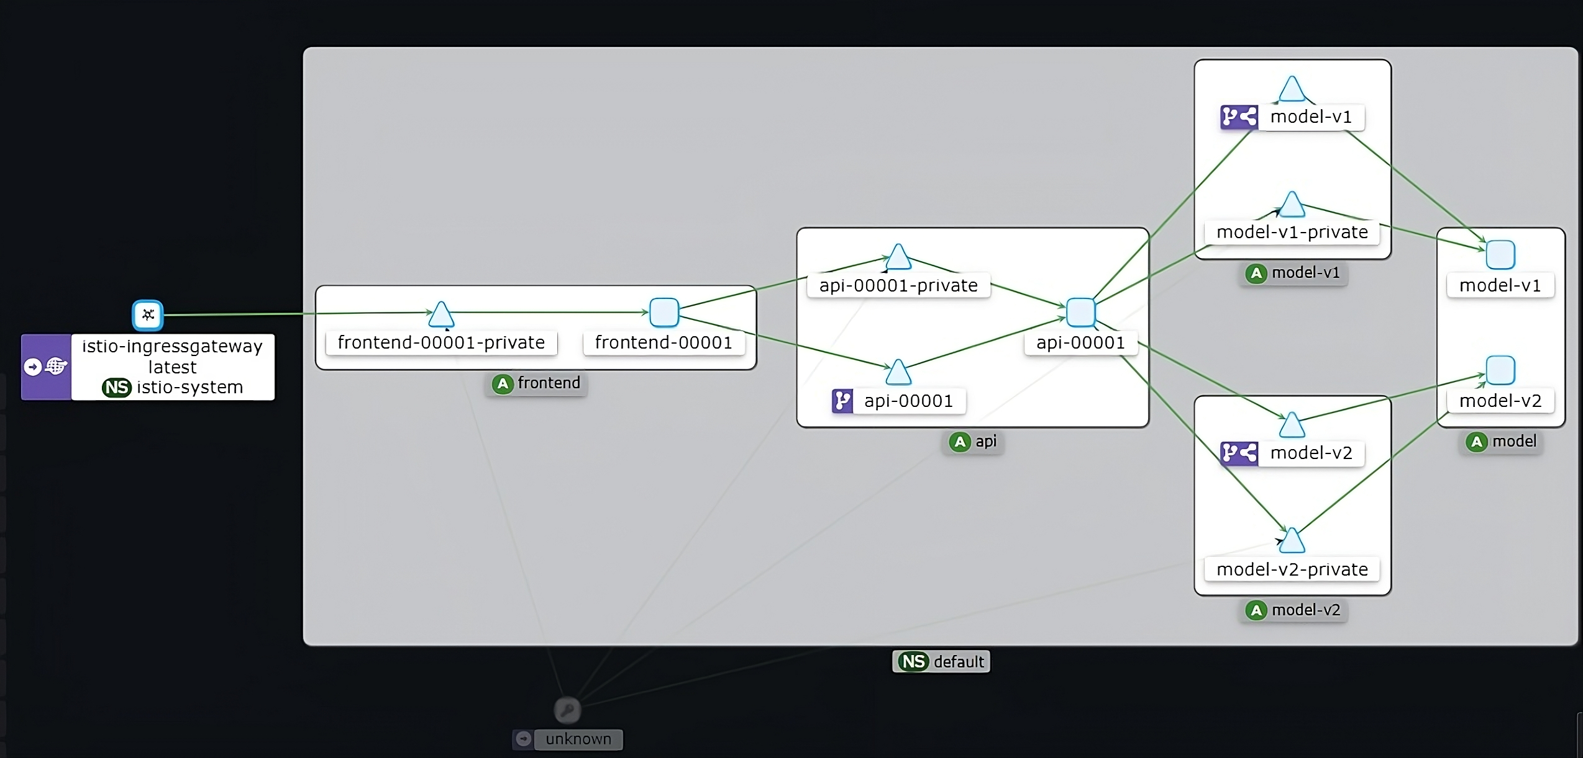
Service Mesh Visualization with Kiali

Slide 5
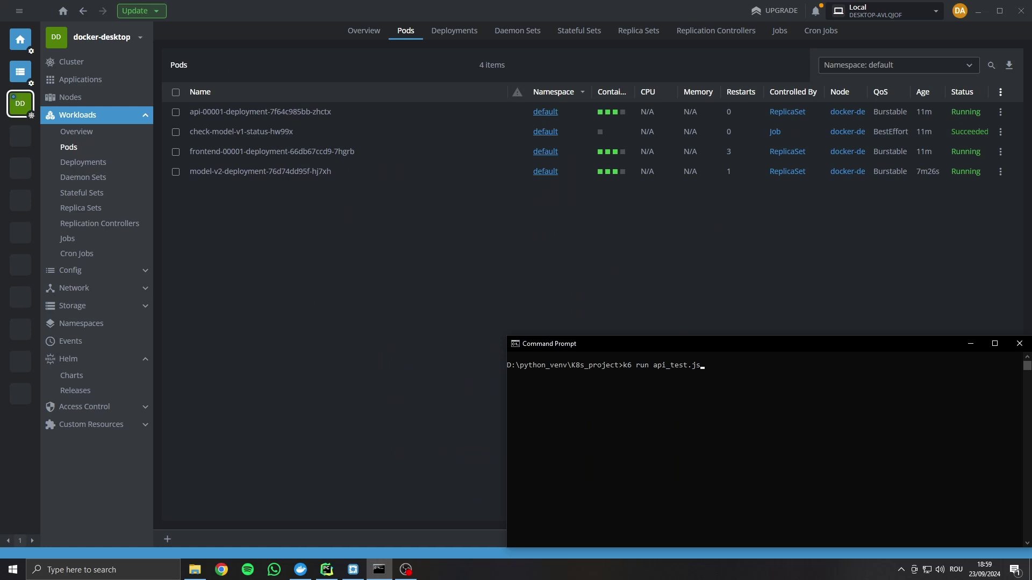
Pods Autoscaling

Slide 6
Q&A

